Slide 1


CREDIT RISK ANALYSIS
EXPLORATORY DATA ANALYSIS(EDA) WITH PYTHON
PREPARED by
JOSEPHINE AKUBILLA
SUPERVISOR: Dr. Aritri Debnath Ghosh

Slide 2

TABLE OF CONTENT
1. Introduction
2. Objectives
3. Problem Statement and goals
4. Data Preparation (Cleaning)
5. Outliers
6. Merging CSV files
7. Univariate analysis
8. Bivariate analysis
9. Multivariate analysis
10. Summary & Conclusion
11. Recommendation

Slide 3

INTRODUCTION
This exploratory data analysis focuses on the challenges clients face in meeting their loan installments. The resulting report can furnish the company with insights into the influential factors contributing to loan difficulties.
Utilizing this information, the company can instigate changes in payment structures through risk assessments, pinpointing the most affected individuals and discerning the underlying reasons.
EDA plays a crucial role in identifying variables and patterns related to repayments and loans, forming the basis for creating hypotheses and predictive models of consumer behavior.
In the 'NAME_CONTRACT_TYPE' field of the previous_application dataset, values such as cash loans or revolving loans indicate scenarios where borrowers can spend borrowed money up to a predetermined limit, subsequently repaying and reusing the amount.

Slide 4

INTRODUCTION
Python is celebrated for its readability, versatility, rich library support, and vibrant community. Jupyter Lab enhances the data science experience with its interactive notebook interface and multi-language support. The collaboration between Python and Jupyter Lab is extensively applied in data science, machine learning, research, and education. This powerful combination is favored by professionals and enthusiasts, fostering innovation in diverse domains. It has emerged as a go-to solution, playing a significant role in problem-solving and advancements across various fields.
TOOLS USED
Python accessed through Jupyter Notebook
• Dictionaries:
• Numphy – Used for numerical applications
• Pandas – the most extensive dictionary used in Python
for data manipulation & analysis
• Matplotlib – Data Visualization
• Seaburn – Statistical Plotting
• Scikit-Lean – Data Analysis & Mining
• Openpyxl – For connectivity through excel (importing

Slide 5

OBJECTIVES
The objective of this project is to identify specific patterns indicative of potential challenges in clients meeting their scheduled payments. The goal is to make informed decisions, such as rejecting loans, reducing loan amounts, or applying higher interest rates to applicants demonstrating a higher risk profile based on these patterns. Ultimately, this approach aims to mitigate risks associated with lending to borrowers who may face repayment difficulties while ensuring that deserving loan applications are not unfairly denied. Additionally, the project seeks to comprehend the primary drivers or variables that significantly contribute to loan defaults, serving as reliable predictors of potential default scenarios. Gaining insights into these crucial variables enables the business to manage its portfolio more adeptly, conduct more precise risk assessments, and make informed decisions, ultimately enhancing strategies to minimize the likelihood of loan defaults.
The dataset comprises three files:
'application_data.csv': This file encompasses comprehensive information about clients sourced from loan applications.
'columns_description.csv': Serving as a data dictionary, this file elucidates the significance of variables within the dataset.
'previous_application.csv': This file contains details about clients' prior loan applications, specifying whether they were approved, rejected, cancelled, or remained unused.

Slide 6

CREDIT RISK ANALYSIS
Credit risk analysis helps financial institutions and lenders make informed decisions about whether to approve or deny a loan, set appropriate interest rates, and establish credit limits.
Additionally, it plays a crucial role in portfolio management, as it helps in monitoring and managing the overall credit risk exposure of an institution.
Due to their weak or nonexistent credit histories, loan providers find it challenging to grant loans or individuals. Because of this, some customers take advantage of it by defaulting.

Slide 7
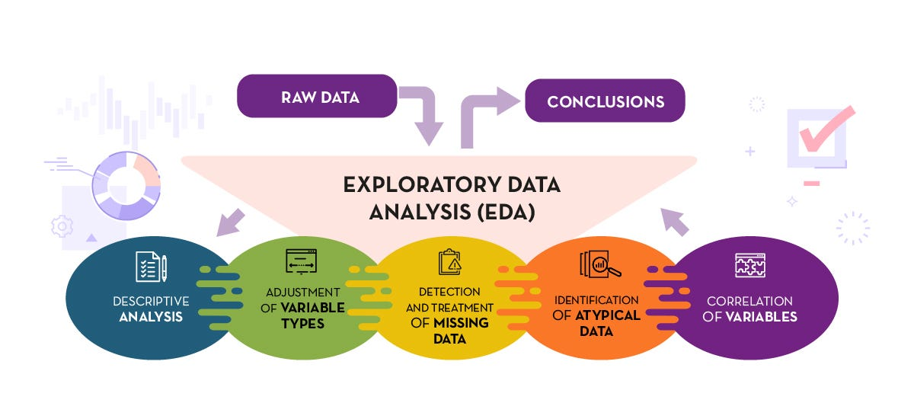
EXPLORATORY DATA ANALYSIS (EDA)
Exploratory Data Analysis (EDA) is an approach to analyzing datasets to summarize their main characteristics, often with the help of graphical representations and statistical techniques. The primary goal of EDA is to uncover patterns, relationships, anomalies, and trends in the data, providing a better understanding of its underlying structure. During EDA, analysts explore the data visually and through summary statistics to identify patterns or insights that can guide further analysis. Techniques involved in EDA include data visualization (histograms, scatter plots, box plots), summary statistics (mean, median, standard deviation), and sometimes more advanced statistical methods. EDA is a crucial step in the data analysis process, helping analysts make informed decisions about subsequent analyses or modeling.

Slide 8
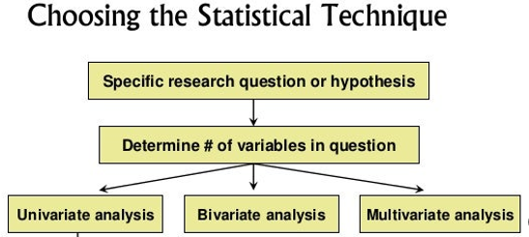
EXPLORATORY DATA ANALYSIS (EDA)
Univariate analysis involves the examination of a single variable, exploring its distribution, central tendency, and variability. It provides insights into the characteristics and patterns within that specific variable.
Bivariate analysis examines the relationship between two variables, assessing how changes in one variable correlate with changes in another. Common methods include correlation and regression analysis.
Multivariate analysis extends the exploration to three or more variables simultaneously. It allows for a comprehensive understanding of complex relationships and interactions among multiple variables, aiding in predictive modeling and decision-making processes.

Slide 9

PROBLEM STATEMENT, MOTIVATION & SIGNIFICANCE

Slide 10
Problem Statement 1: Enhancing Loan Repayment Strategies
Challenge: Clients encounter difficulties in meeting their loan installments.
Motivation: Improve company understanding of influential factors causing loan challenges.
Significance: A well-informed strategy can enhance payment structures, mitigating risks and benefiting both clients and the company.
Problem Statement 2: Targeted Risk Assessment for Payment Changes
Challenge: Determining the most affected individuals and reasons behind loan difficulties.
Motivation: Utilize data insights to initiate targeted risk assessments and strategic payment changes.
Significance: Pinpointing high-risk cases enables proactive measures, ensuring a more secure and stable loan portfolio.
Problem Statement 3: Predictive Modeling for Consumer Behavior
Challenge: Identifying variables and patterns related to repayments and loans.
Motivation: Leverage EDA to form hypotheses and predictive models of consumer behavior..
Significance: Predictive models enhance decision-making, allowing the company to anticipate and respond effectively to consumer trends
Problem Statement 4: Optimization of Cash and Revolving Loans
Challenge: Understanding the dynamics of 'NAME_CONTRACT_TYPE' values (e.g., cash loans, revolving loans).
Motivation: Analyze borrower behavior in scenarios of spending, repaying, and reusing funds.
Significance: Optimization ensures tailored lending solutions, aligning with borrower needs and fostering financial flexibility.

Slide 11
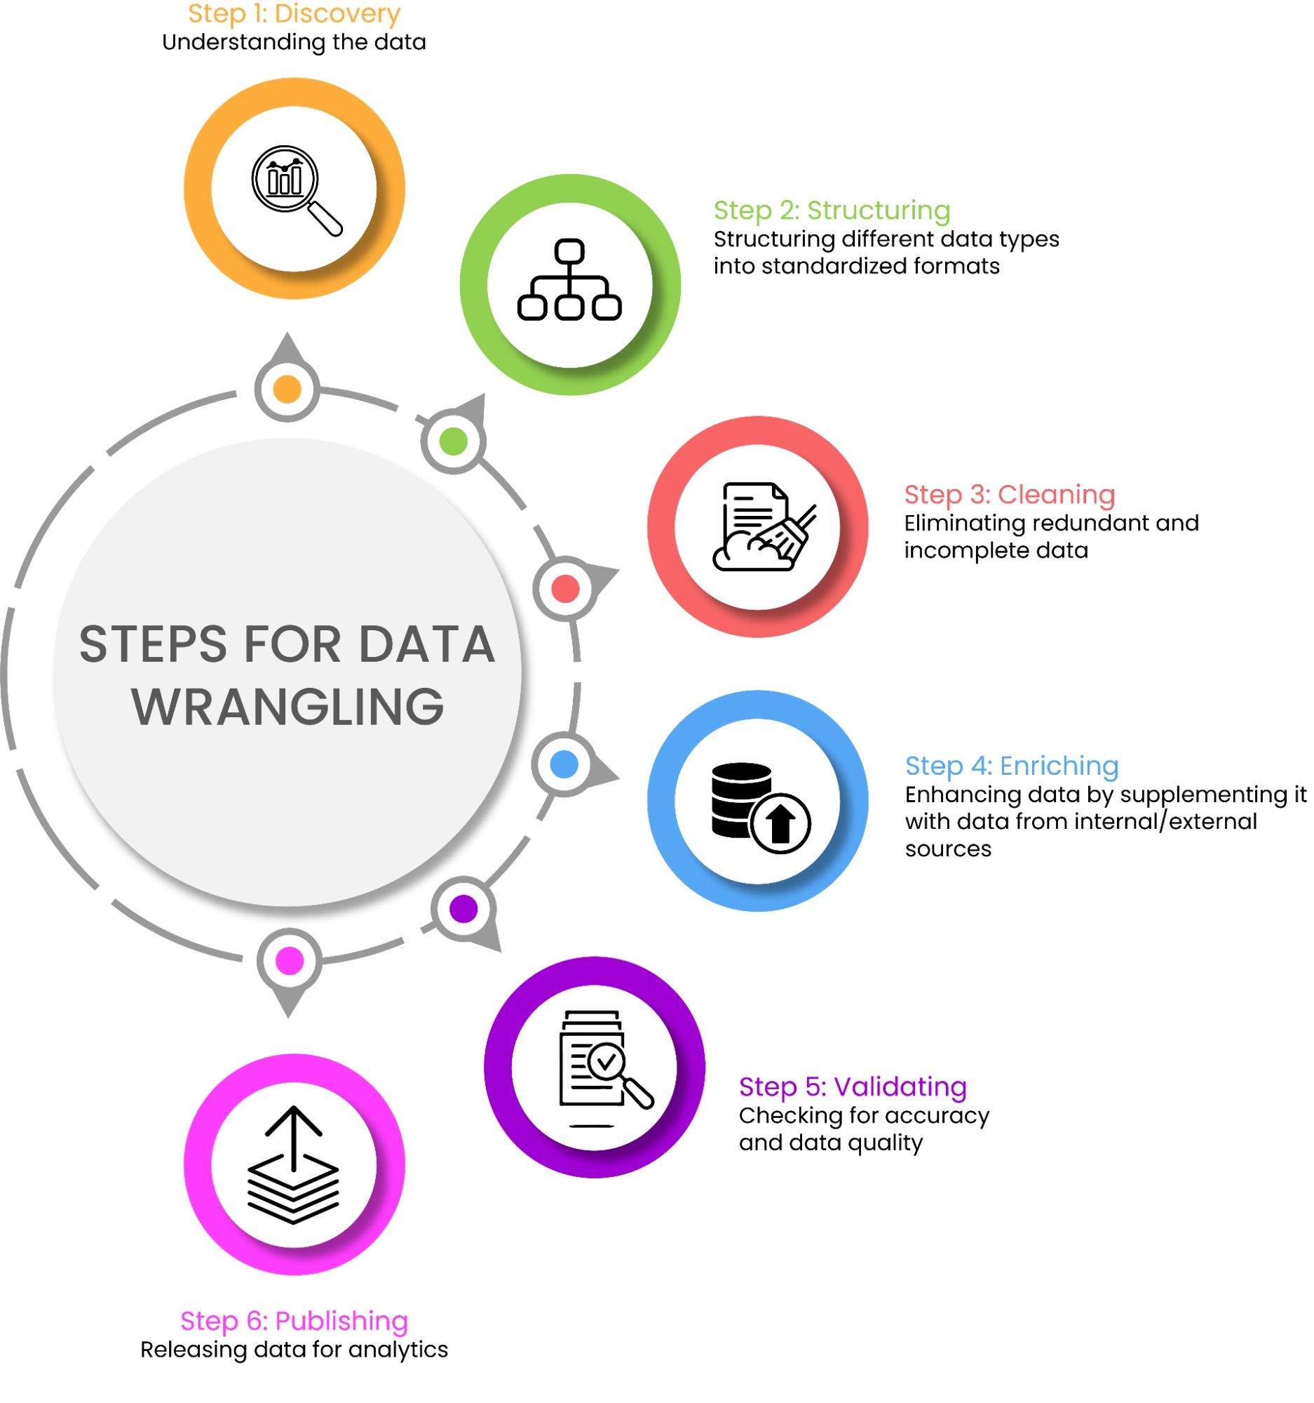
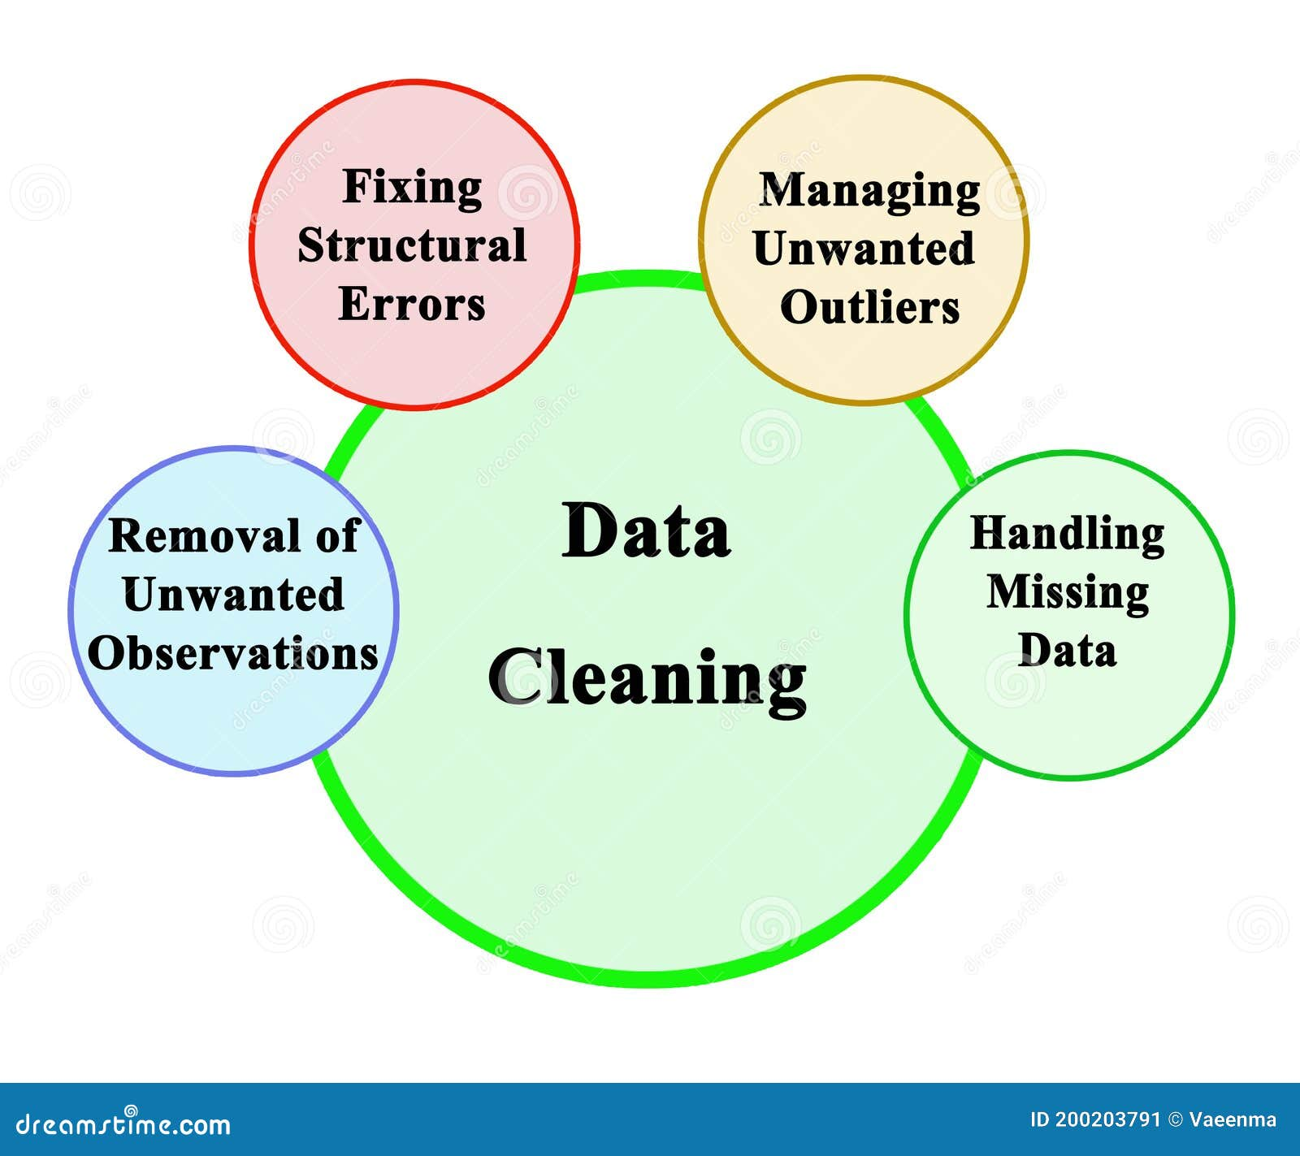
DATA PREPARATION

Slide 12
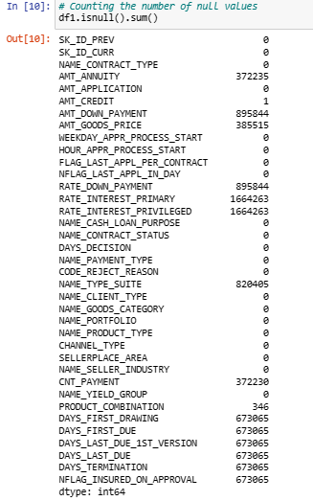
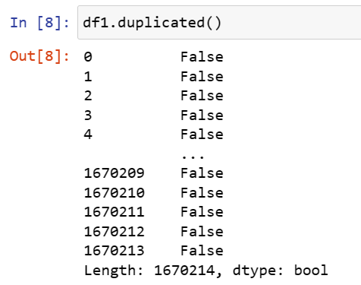
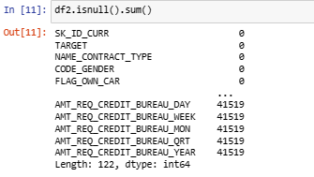
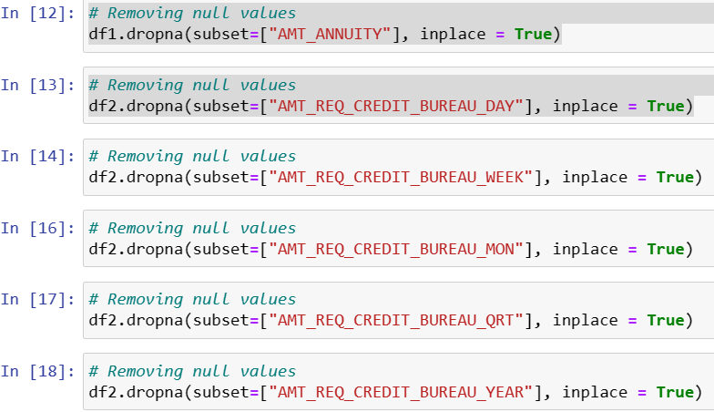
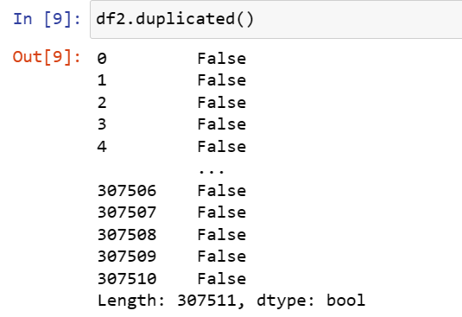
DATA CLEANING

Slide 13
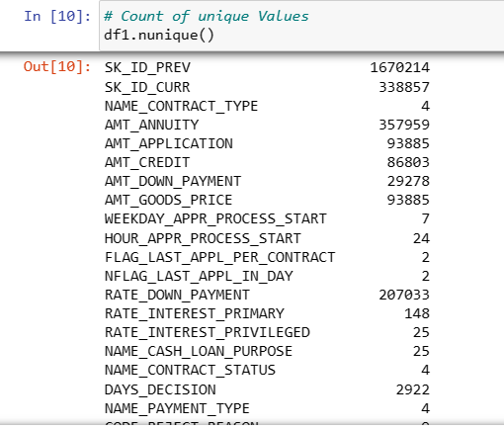
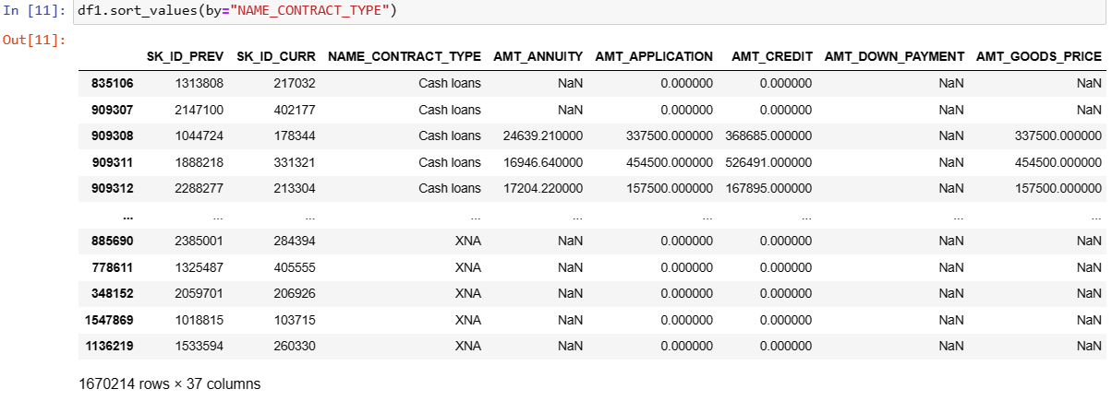
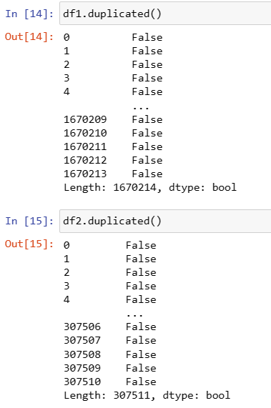
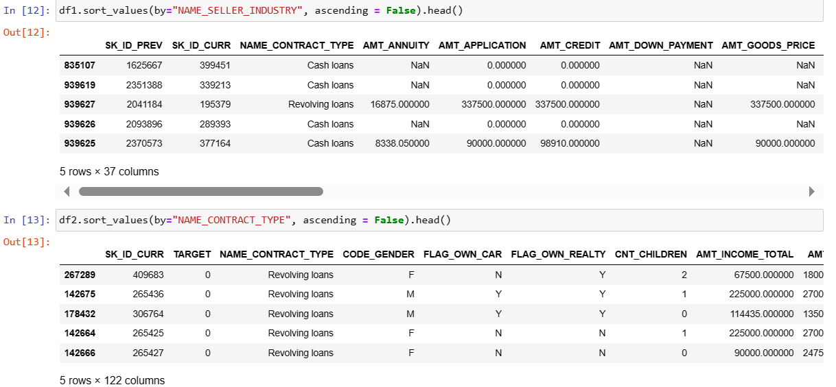
DATA CLEANING

Slide 14

OUTLIER DETECTION
An outlier is a data point that significantly deviates from the majority in a dataset, standing as an extreme value. It falls outside the usual range and can distort statistical analyses if not properly addressed. Outliers may result from errors, natural variations, or unusual events. Identifying outliers is crucial in data analysis to ensure accurate interpretations of results. Detection methods include visual inspection, statistical techniques like z-scores and interquartile range, and machine learning algorithms. Handling outliers involves a careful decision on whether to remove them or consider them as valuable, albeit unusual, observations. Ultimately, managing outliers is essential for maintaining the integrity and reliability of statistical analyses.
AMT_INCOME_TOTAL mean = 1.71275
AMT_CREDIT mean = 6.063205
AMT_ANNUITY mean = 27174.6
AMT_GOODS_PRICE mean = 5.45

Slide 15
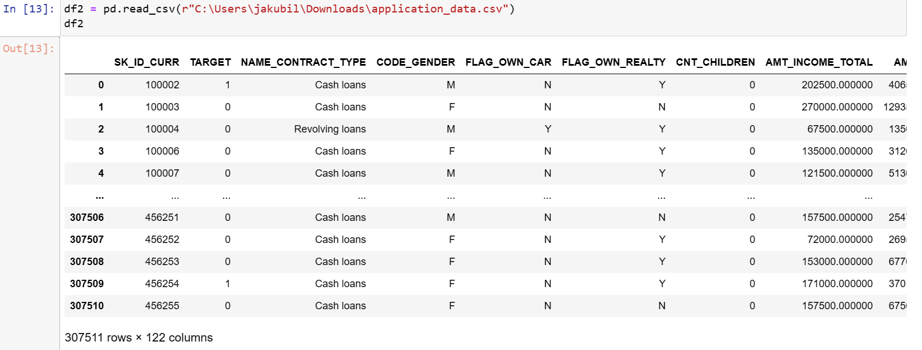
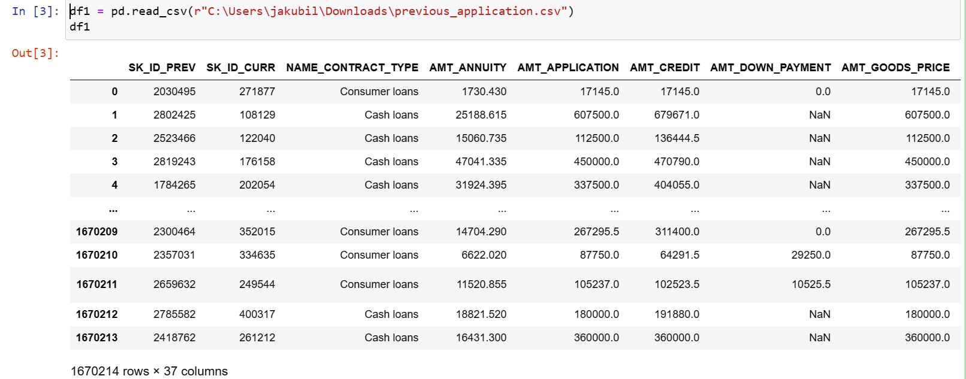
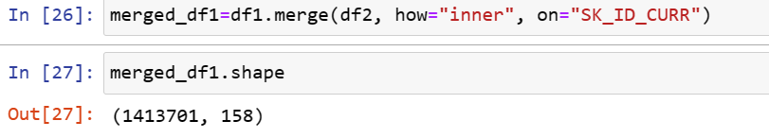
COMBINING DATA SETS (MERGING CSV FILES)
In Python, conducting a comprehensive analysis involves merging datasets to integrate information from diverse sources for a holistic perspective. Utilizing the 'merge_df' command, I combined two CSV files to create a consolidated dataset with 1,670,214 rows and 158 columns. The primary goal was to enhance analytical capabilities with a larger, well-labeled dataset for easy interpretation. The harmonization achieved through merging facilitates effective correlation between related data points, deepening insights. The unified structure resulting from merging streamlines subsequent data manipulation and exploration tasks, promoting workflow efficiency. Furthermore, the process eliminates challenges related to handling heterogeneous data types during analysis. After merging, the column remains the same whereas the row decreases to 1413701.

Slide 16


Slide 17
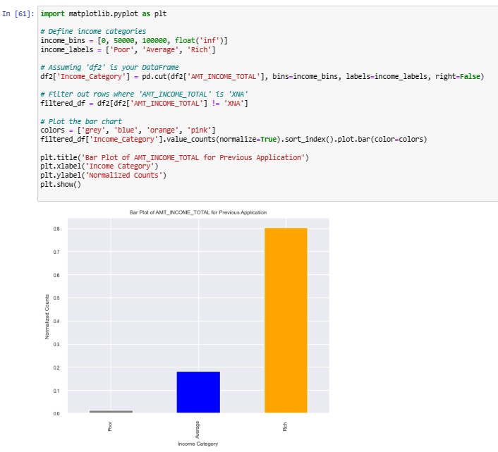
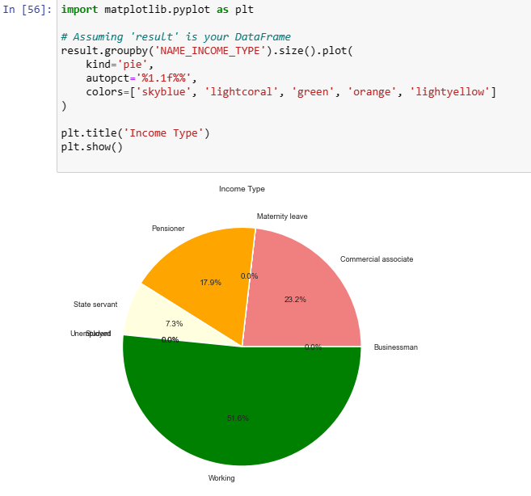
DEMOGRAPHIC CHARACTERISTICS

Slide 18
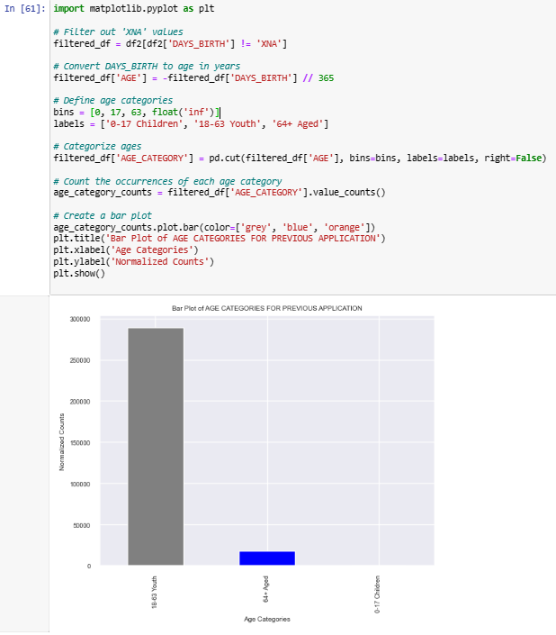
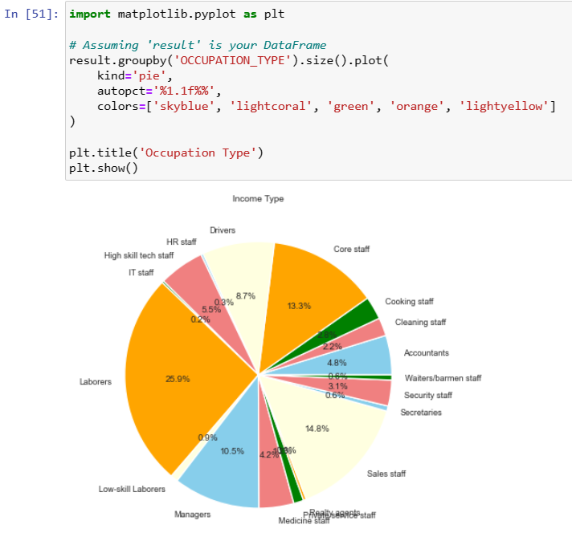
DEMOGRAPHIC CHARACTERISTICS

Slide 19
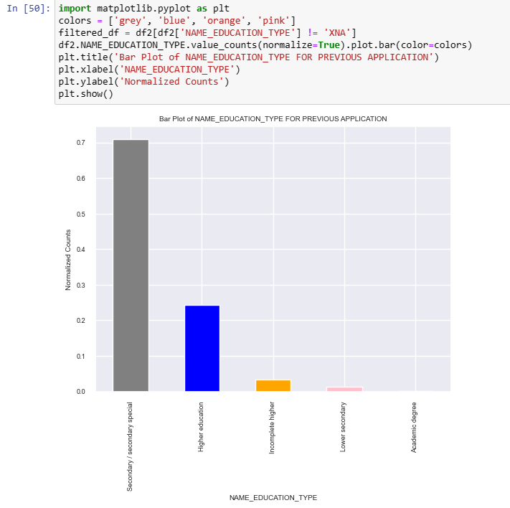
DEMOGRAPHIC CHARACTERISTICS

Slide 20
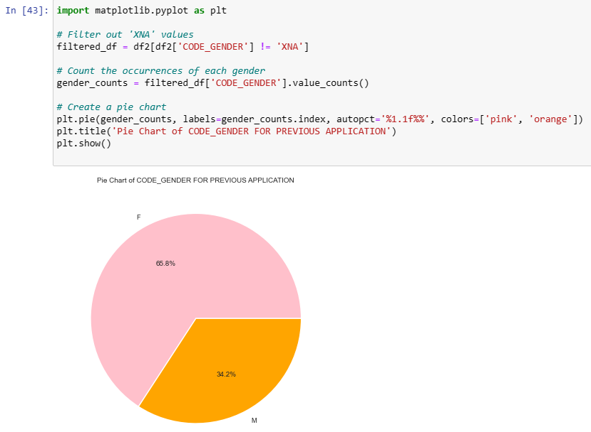
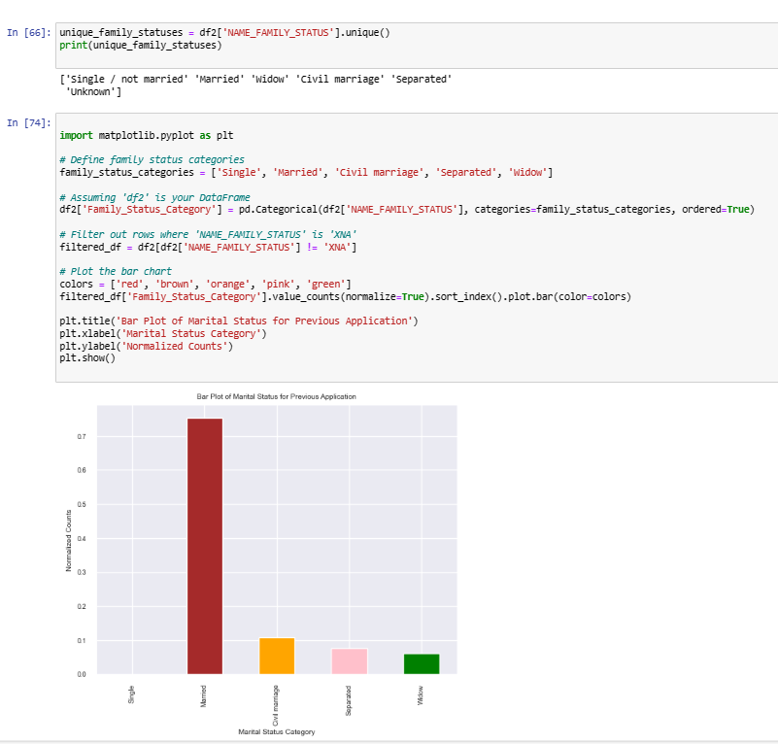
DEMOGRAPHIC CHARACTERISTICS

Slide 21
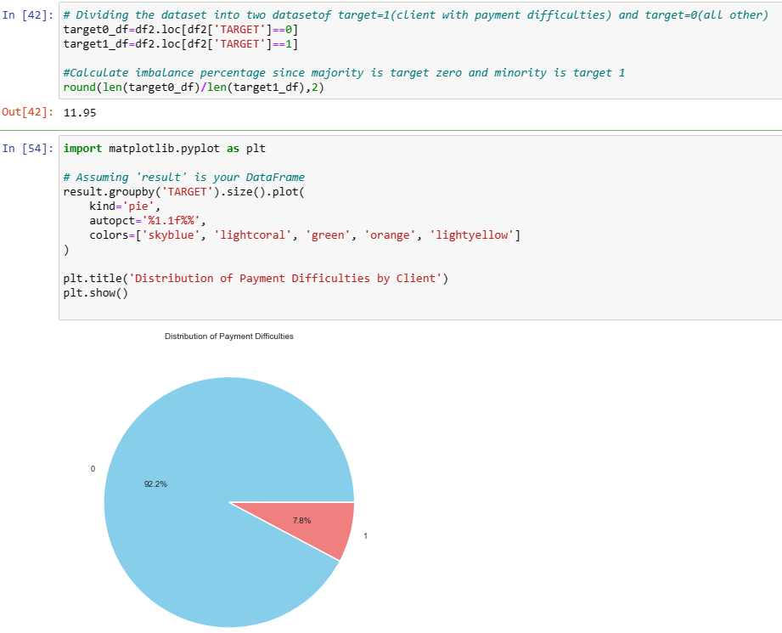
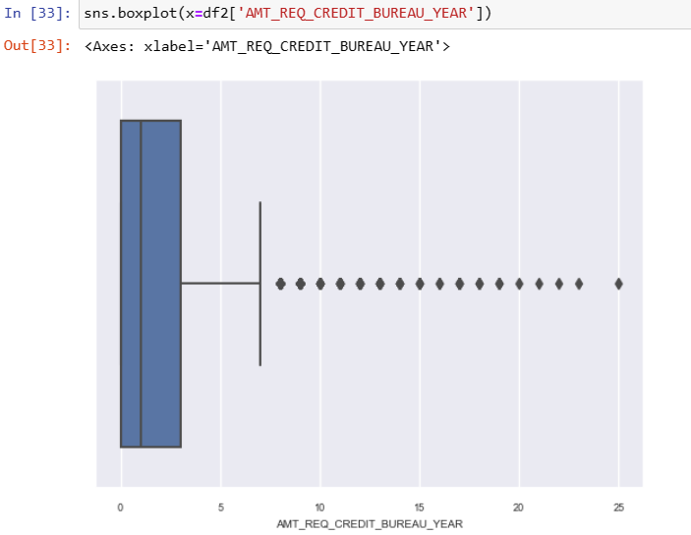
DISTRIBUTION OF PAYMENT DIFFICULTY BY CLIENT

Slide 22

BIVARIATE ANALYSIS

Slide 23
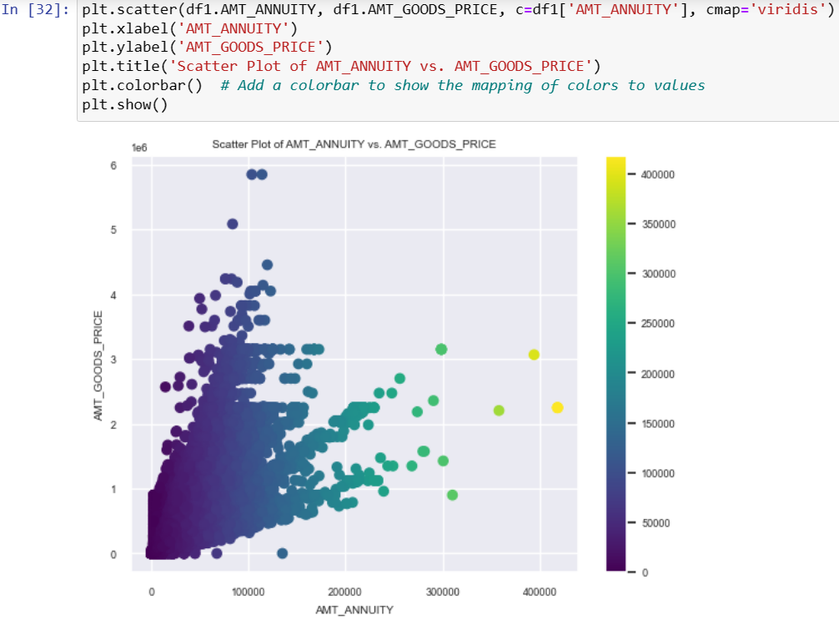
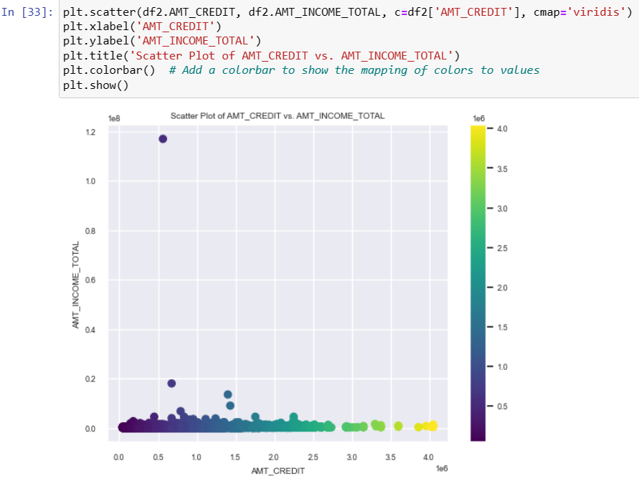
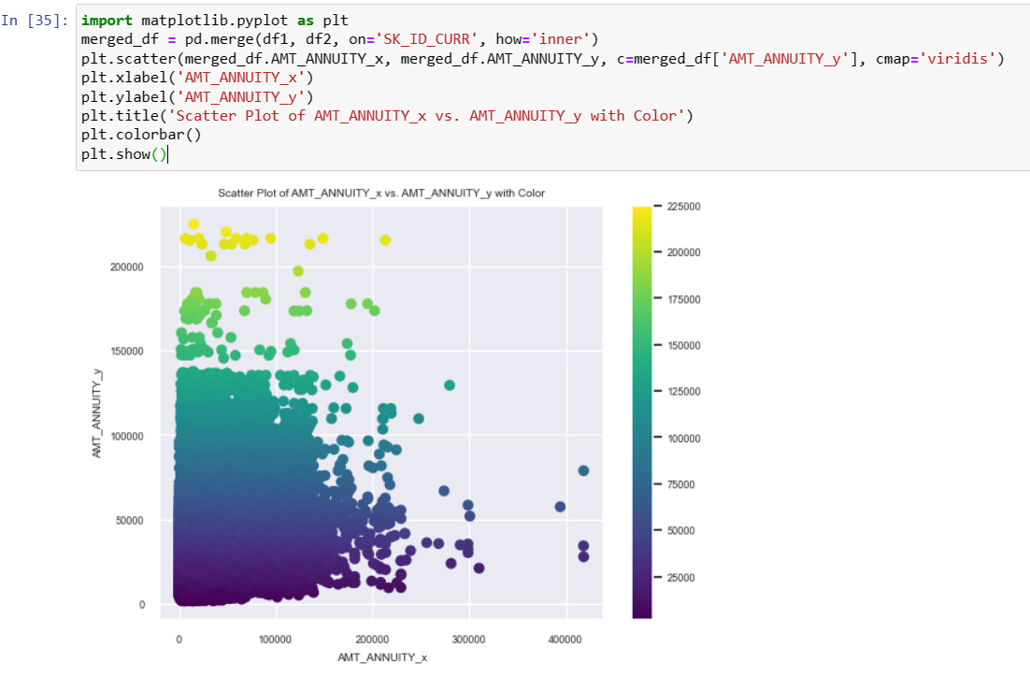
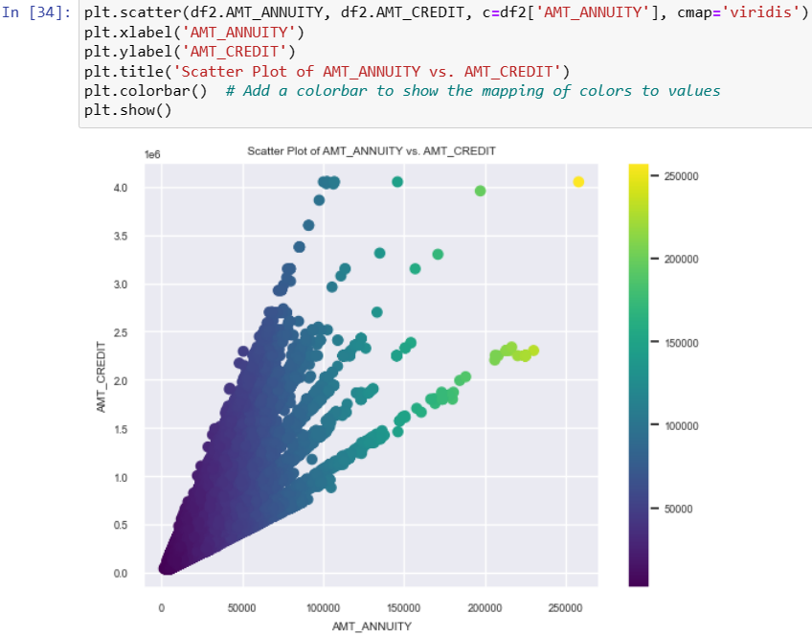
CORRELATION ANALYSIS

Slide 24
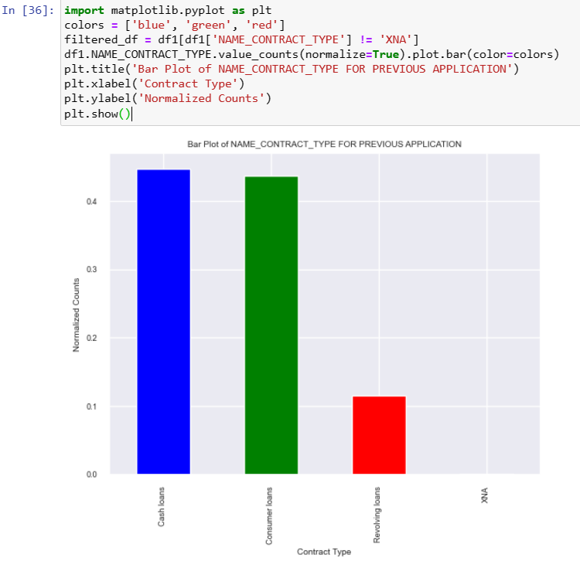
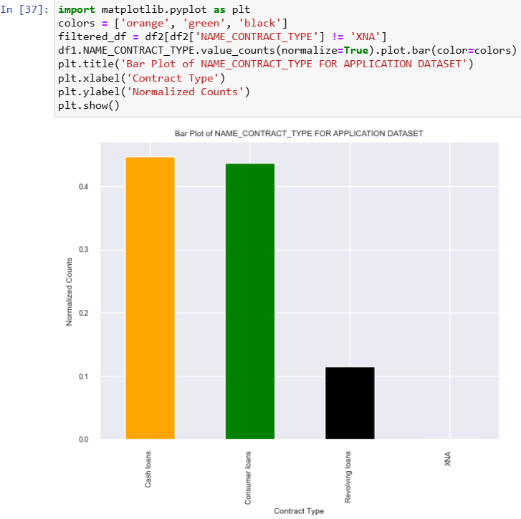
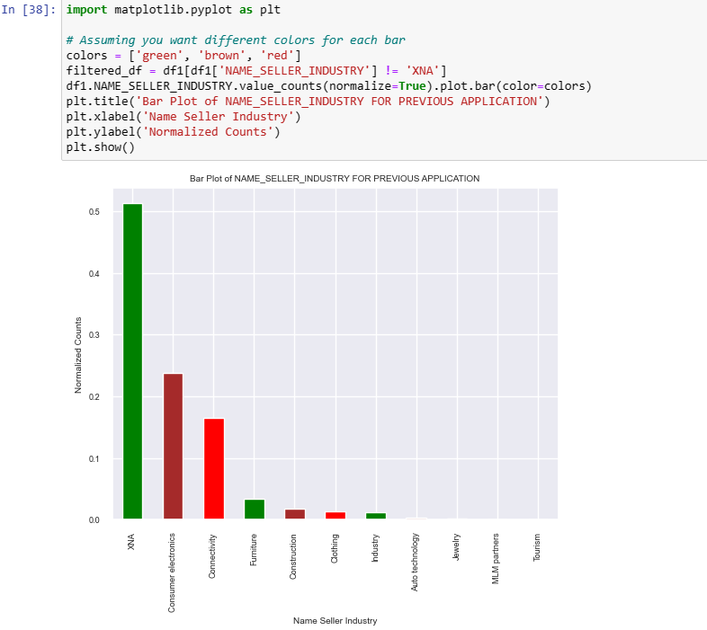
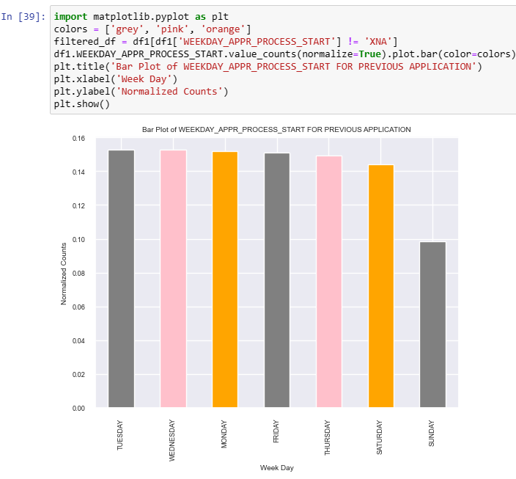
CORRELATION ANALYSIS

Slide 25
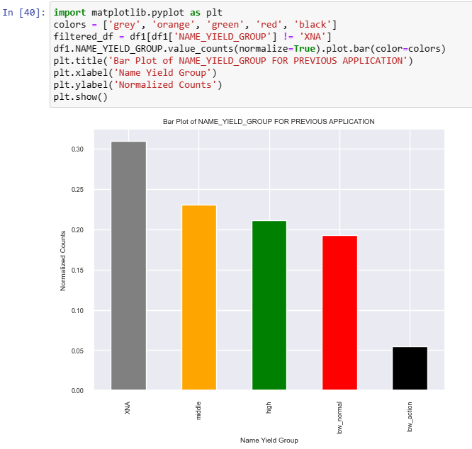
CORRELATION ANALYSIS
Bivariate analysis in Python is centered on examining connections between two variables. Utilizing libraries such as Pandas, Seaborn, and Matplotlib (plt), one can generate visualizations like histograms and box plots, offering a lucid portrayal of the distribution and central tendencies of the variables under consideration.
The majority of variables in the scatterplot above exhibit a positive correlation with each other. The steeper the gradient, the stronger the correlation between the variables. Specifically, the relationship between AMT_CREDIT and AMT_GOODS_PRICE displays the most linear pattern, suggesting that credit plays a significant role in influencing the purchasing behavior of high-value goods. This linearity implies that higher inflation rates may lead to increased prices of goods, while changes in interest rates can impact the cost of credit. On the other hand, AMT_INCOME_TOTAL shows a more random correlation with no distinct patterns.

Slide 26
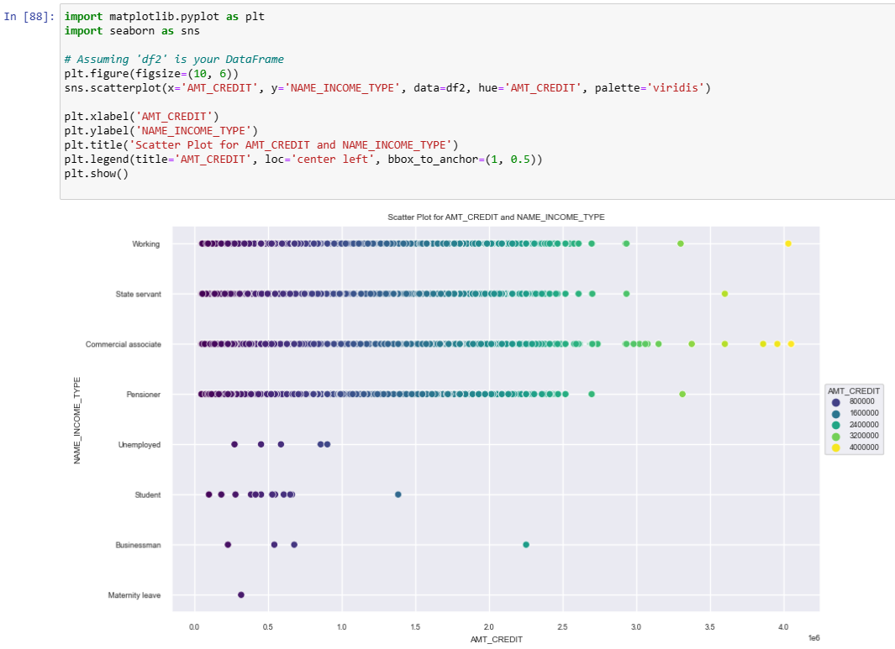
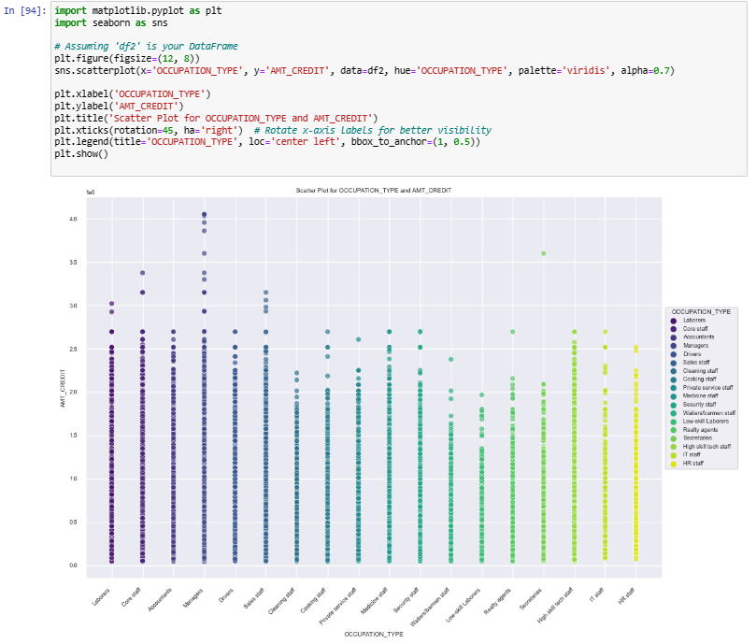
EFFECT OF INCOME TYPE & OCCUPATION ON AMOUNT OF CREDIT
Individuals whose income type is commercial associates earn higher credit followed by individuals whose income type is working. Students, the unemployed and businessmen receive lower credit amounts. Women on maternity leave receive the lowest credit amount

Slide 27
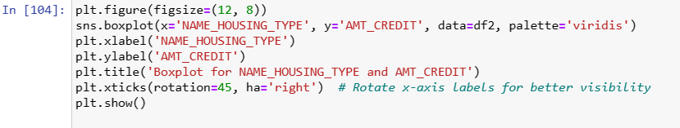
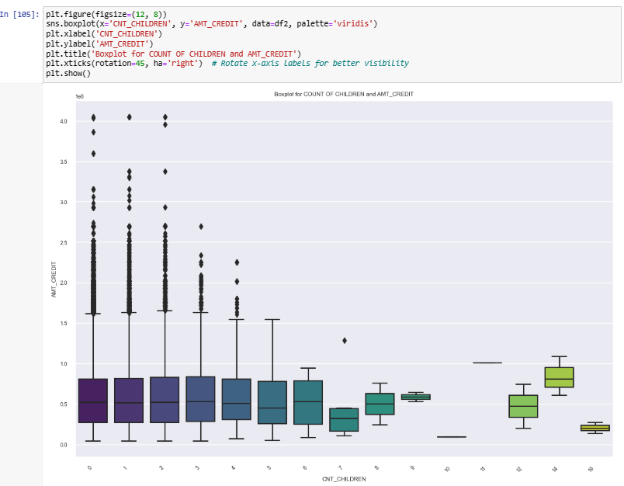
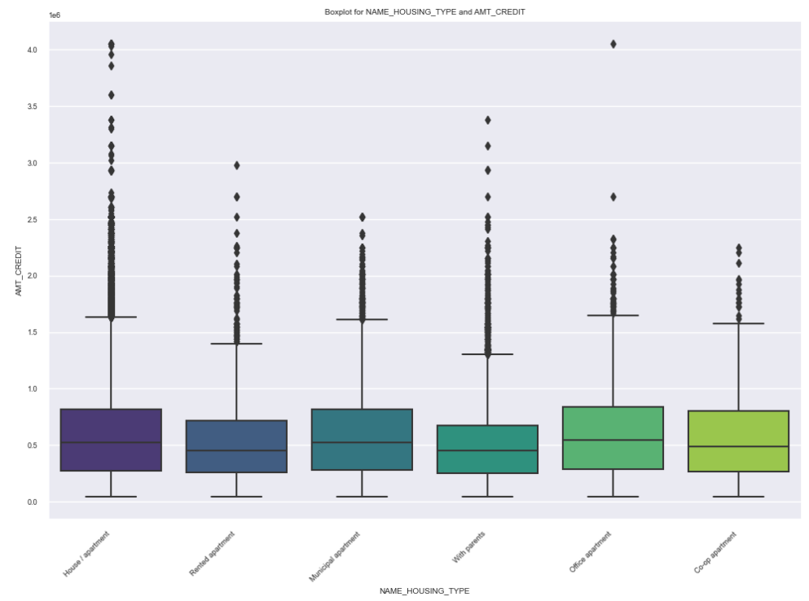
EFFECT OF HOUSING TYPE & NUMBER OF CHILDREN ON AMOUNT OF CREDIT RECEIVED

Slide 28

MULTIVARIATE ANALYSIS

Slide 29
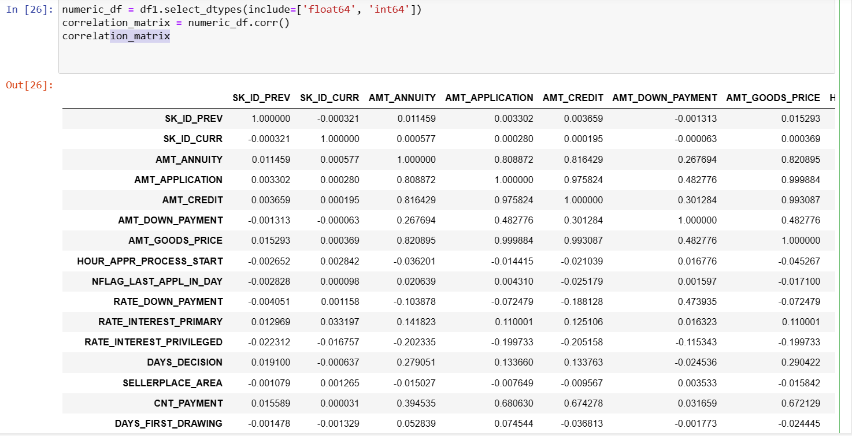
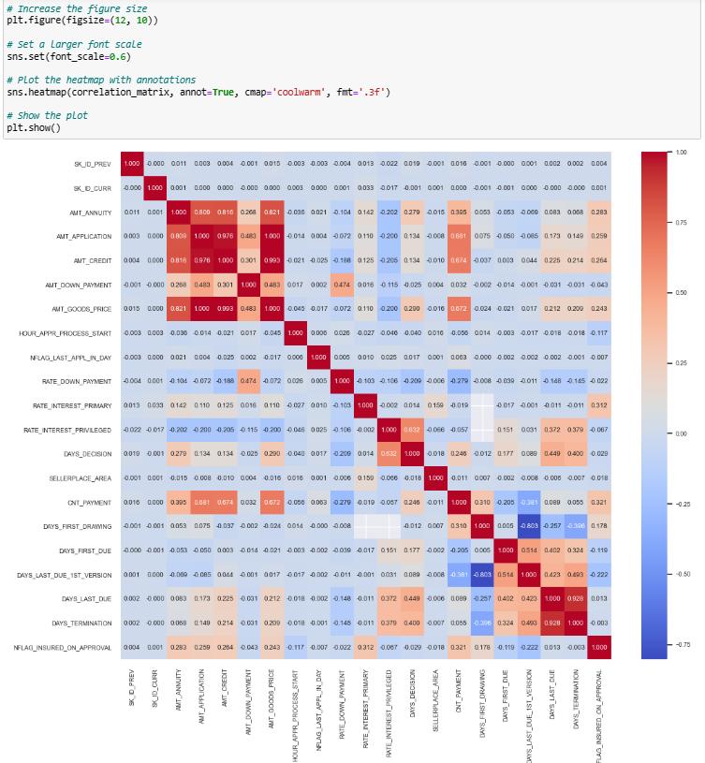
CORRELATION HEATMAP
The correlation heatmaps consistently depict a correlation of 1, evident by a consistently dark green color in each row, signifying a positive correlation. Notably, AMT_ANNUITY and AMT_APPLICATION exhibited a strong correlation. The presence of multicollinearity is suggested, indicating that when multiple variables are highly correlated, it can impact regression models. In the context of positive correlation, an increase in one variable is associated with a tendency for other variables to increase as well.

Slide 30
CONCLUSION & SUMMARY
The bank experienced a greater influx of loan applications from female customers compared to their male counterparts. Most of the loan requests come from individuals aged between 30 and 40, with the 40-50 age group closely trailing behind. A notable proportion of applicants sought cash loans, while the demand for revolving loans was relatively modest. In terms of occupational categories, the largest portion of applicants belongs to the working class, followed by commercial associates and state servants. The prevailing educational background among loan applicants is Secondary/Secondary Special, followed by Higher Education. The majority of applicants seeking relatively larger loan amounts belong to the married category in both Defaulters and Non – Defaulters.
There was a considerable reduction in the proportion of cash loans, accompanied by a shift in the purchasing trend towards higher-value goods using cash loans in the recent dataset compared to the previous one. The average repayment term also exhibited a significant uptick between the two sets of data. The heatmap analysis revealed a negative correlation between income and credit, indicating that as income decreases, credit tends to increase. In contrast, there was a notable positive correlation between credit and annuity variables, suggesting a relationship where higher credit is associated with increased annuity. The identification and removal of outliers across various loan types aimed to enhance the accuracy and clarity of the dataset representation.

Slide 31

RECOMMENDATIONS
Continuous monitoring of applications with exceptionally high annuity amounts is imperative for banks to proactively identify potential risks, based on historical data.
The ability to identify and respond to potential risks within loan applications is foundational to a proactive risk management approach that safeguards the financial stability of the bank. In response, strategic measures such as reducing the loan amount or applying a higher interest rate should be considered by banks to mitigate potential risks associated with applicants with dependents.
Evaluating a borrower's ability to meet financial obligations should encompass a thorough analysis of credit amount and annuity payments, referencing historical data for comprehensive insights.
Applicants with high credit scores showcase robust creditworthiness, prompting the bank to consider approving loans for this segment, aligning with a lower-risk profile.
Monitoring and adapting to changing risk factors is crucial for banks to make informed and dynamic decisions, ensuring the overall health of their lending portfolios.

Slide 32

THANK YOU

